Slide 1
Drone rock classification
Domenico, Misael

Slide 2
Multispectral Camera

Slide 3
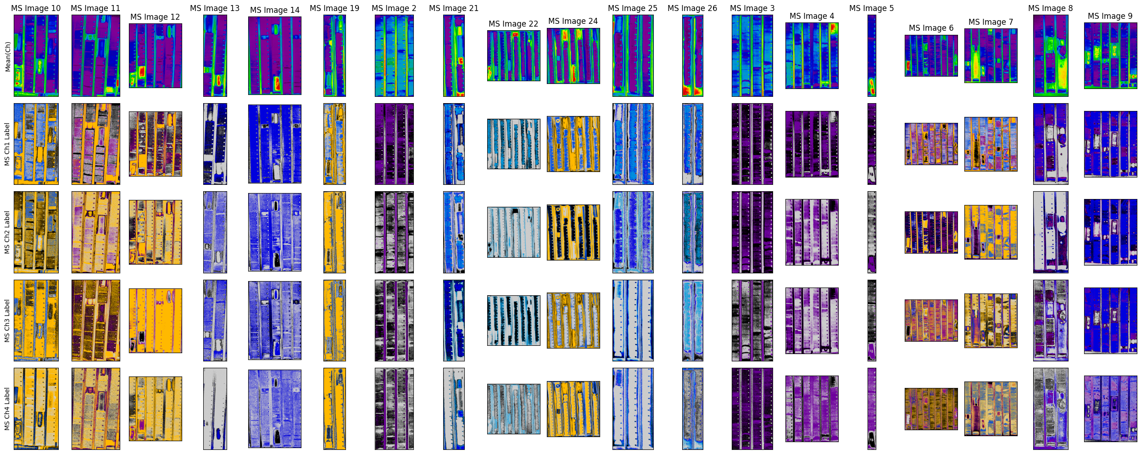
Loading the data

Slide 4
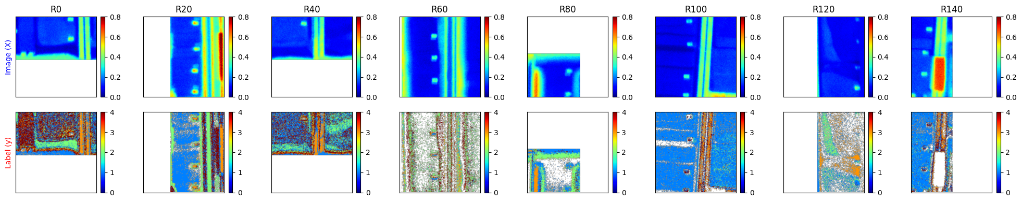
Inputs/Outputs – Argmax over classes

Slide 5
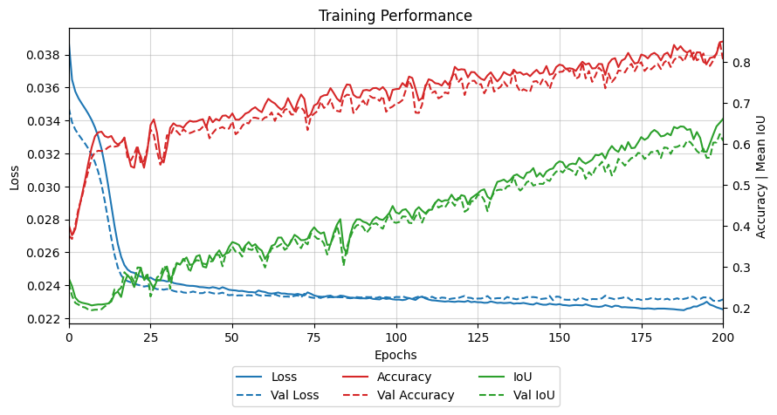
Training performance

Slide 6
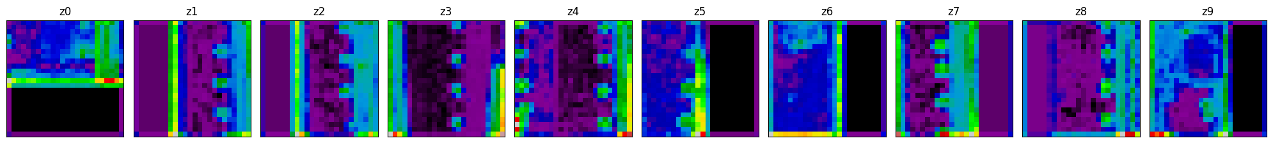
Latent space

Slide 7
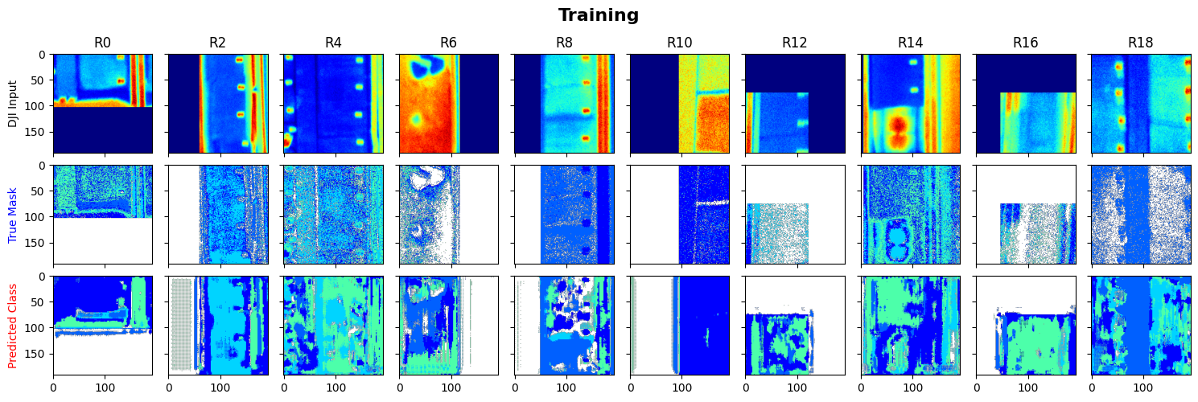
Predictions

Slide 8
Fast metrics
MSE - Train: 0.026 | Test: 0.026
SSIM - Train: 0.139 | Test: 0.116
Accuracy - Train: 0.252 | Test: 0.183

Slide 9
Conventional Camera

Slide 10
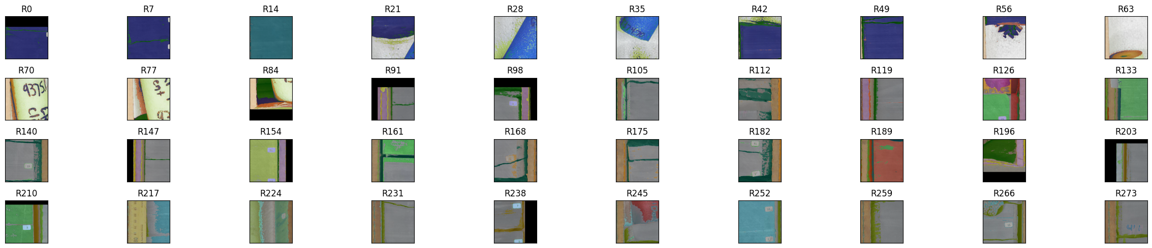
Load conventional camera photos

Slide 11
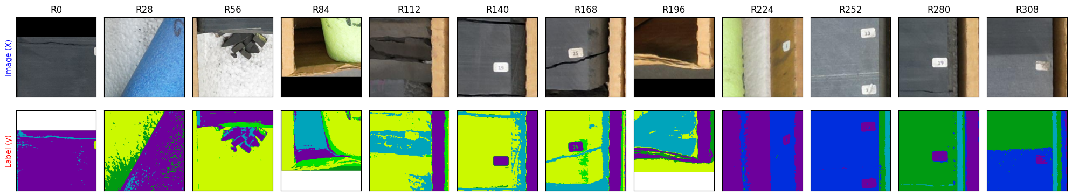
Inputs/Outputs – Argmax over classes

Slide 12
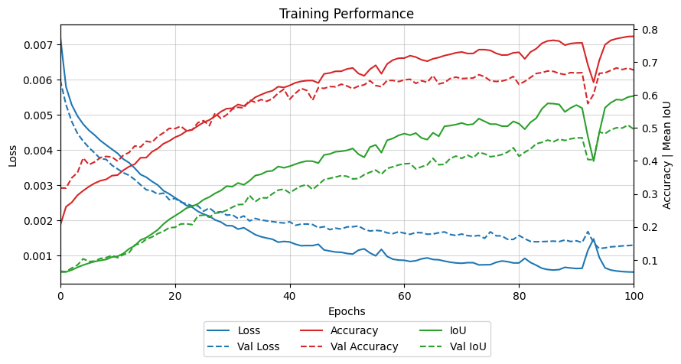
Training performance

Slide 13
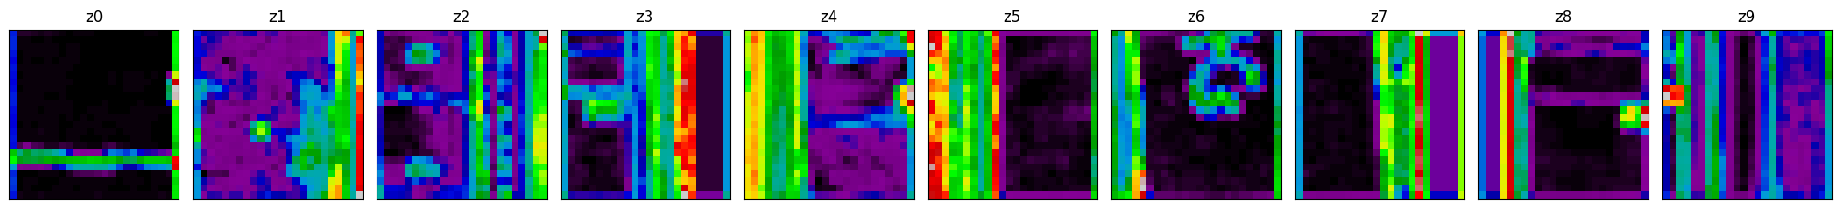
Latent space

Slide 14
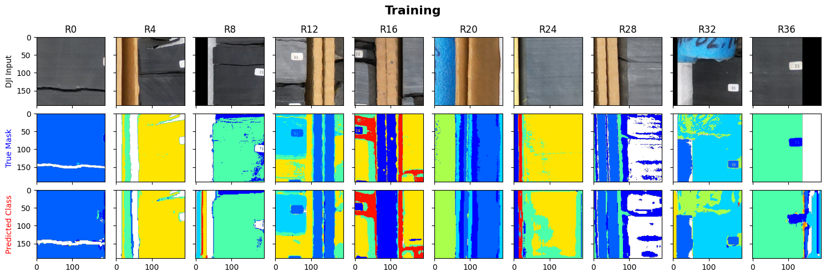
Predictions

Slide 15
Fast metrics
MSE - Train: 0.060 | Test: 0.052
SSIM - Train: 0.289 | Test: 0.296
Accuracy - Train: 0.829 | Test: 0.561

Slide 16
Dual model

Slide 17
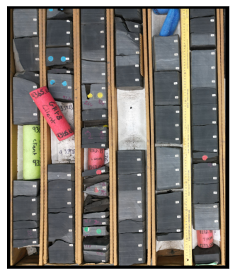
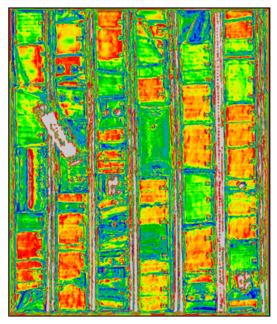
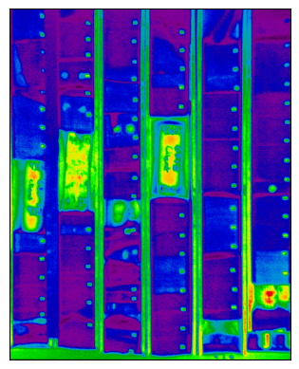
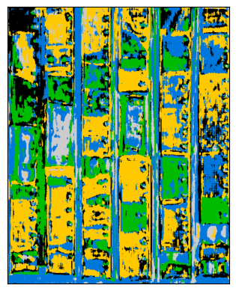







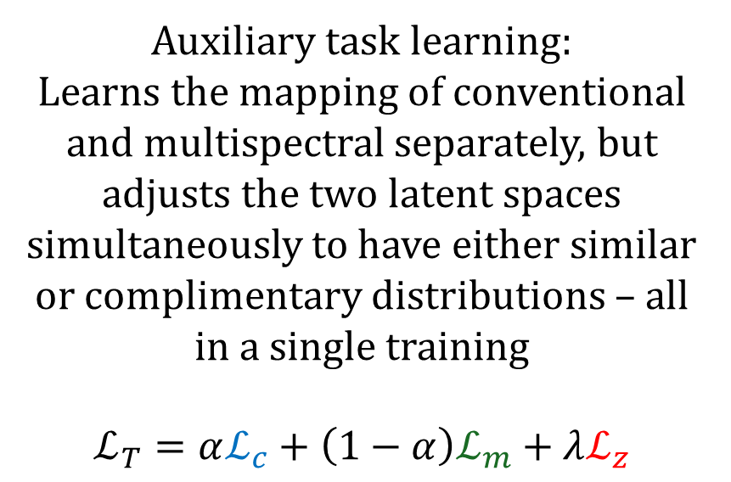


Conventional Camera
residual connection
Auxiliary task learning:
Learns the mapping of conventional and multispectral separately, but adjusts the two latent spaces simultaneously to have either similar or complimentary distributions – all in a single training
$$ℒ_{T}=αℒ_{c}+\left(1−α\right)ℒ_{m}+λℒ_{z}$$
$$z_{c}$$
$$ℰ_{c}$$
$$𝒟_{c}$$
$$ℒ_{c}$$
$$ℒ_{z}$$
Multispectral Camera
$$z_{m}$$
$$ℰ_{m}$$
$$𝒟_{m}$$
$$ℒ_{m}$$

Slide 18
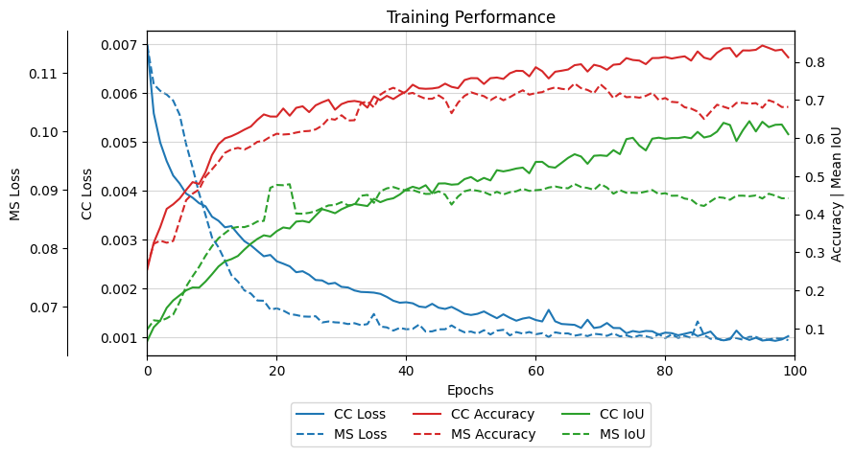
Training performance

Slide 19
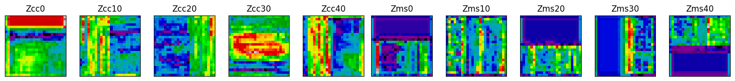
Latent spaces

Slide 20
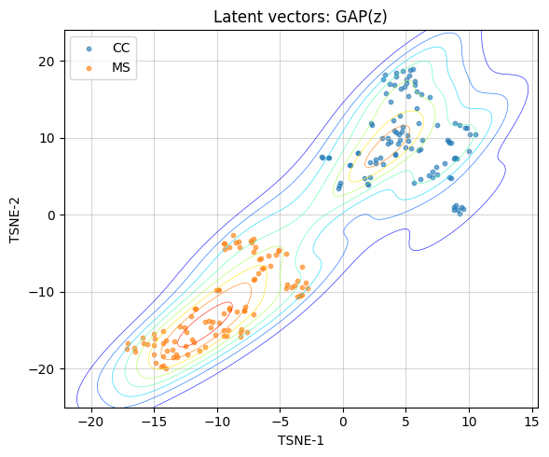
Latent space distributions (tSNE)

Slide 21
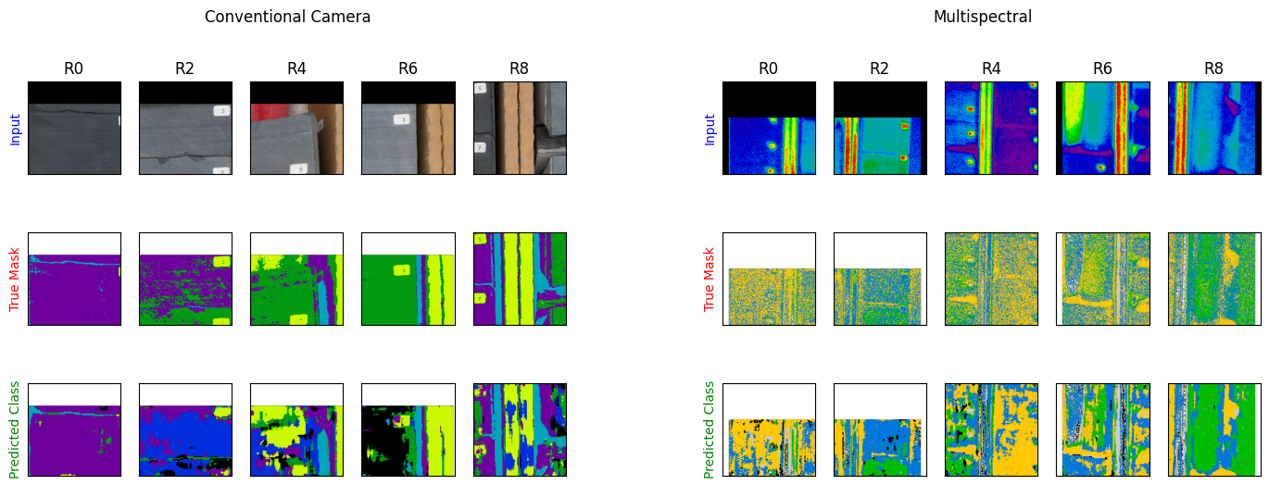
Joint Predictions

